Slide 1
Patent Ductus Arteriosus (PD A)

Slide 2
Patent ductus arteriosus (PDA) is a condition in which a blood vessel called the ductus arteriosus fails to close normally in an infant soon after birth. (The word "patent" means open.)
Cause
Genetics may play a role. A defect in one or more genes could prevent the ductus arteriosus from closing normally after birth.

Slide 3
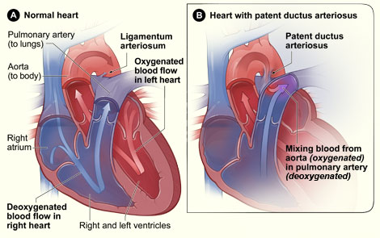
Patent Ductus Arteriosus

Slide 4
Clinical Features
Females -predominant
Asymptomatic for many years.
Symptoms – dysponea,fatigue,cardiac failure etc
Pulse- collapsing type
Left ventricular enlargement

Slide 6
On Examination :
a continuous ‘machinery’ or “train in tunnel” murmur with late systolic accentuation (Gibson ‘s murmur) – heard over the left second intercostal space away from the sternal border , accompanied by thrill .
Reversed splitting of S2 may be present.
A large left to right shunt in infancy, may cause ↑ in pulmonary artery pressure,

Slide 7
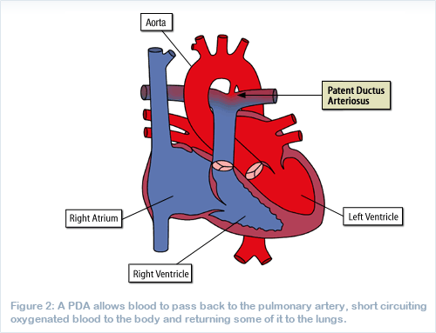

Slide 8
Complications
Infective endocaditis
Congestive cardiac failure
Pulmonary Hypertension with shunt reversal producing differential cyanosis.
Hoarseness of voice due to pressure over recurrent laryngeal nerve.

